Slide 1
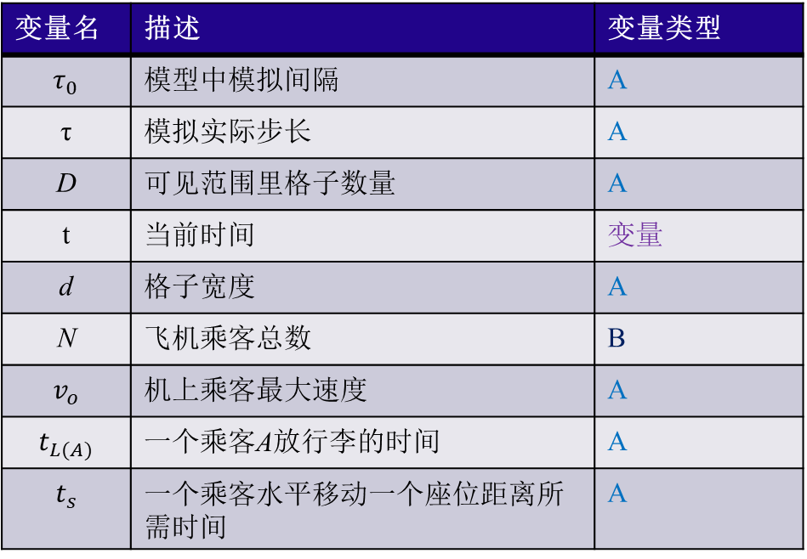
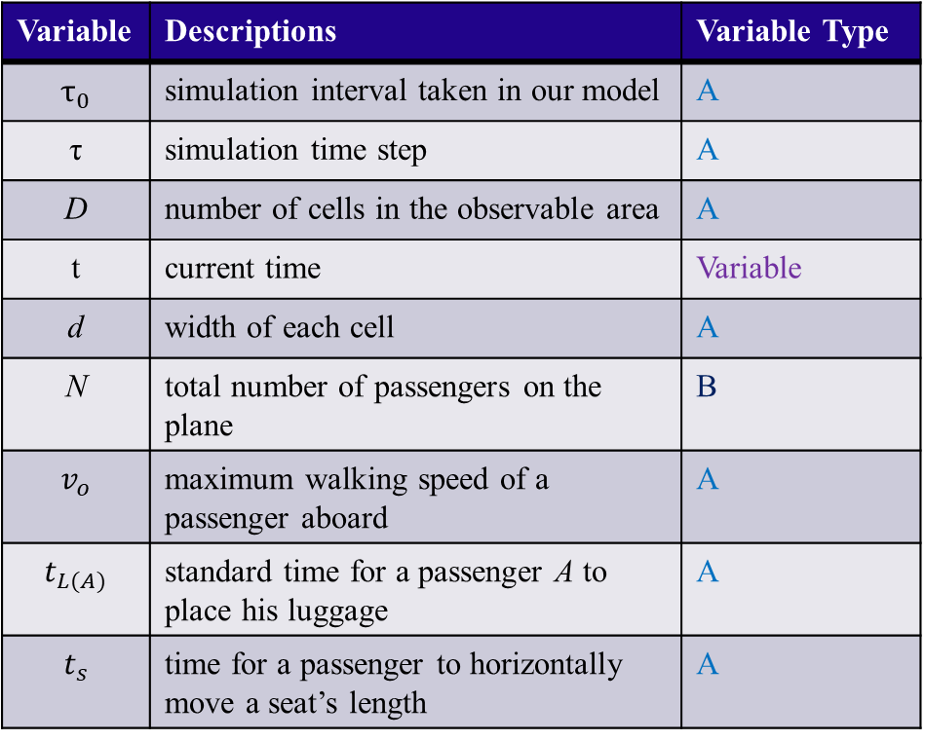
Notation
Variable | Descriptions | Variable Type
$$τ_{0}$$ | simulation interval taken in our model | A
τ | simulation time step | A
D | number of cells in the observable area | A
t | current time | Variable
d | width of each cell | A
N | total number of passengers on the plane | B
$$v_{o}$$ | maximum walking speed of a passenger aboard | A
$$t_{L(A)}$$ | standard time for a passenger A to place his luggage | A
$$t_{s}$$ | time for a passenger to horizontally move a seat’s length | A
变量名 | 描述 | 变量类型
$$τ_{0}$$ | 模型中模拟间隔 | A
τ | 模拟实际步长 | A
D | 可见范围里格子数量 | A
t | 当前时间 | 变量
d | 格子宽度 | A
$$\text{N}$$ | 飞机乘客总数 | B
$$v_{o}$$ | 机上乘客最大速度 | A
$$t_{L(A)}$$ | 一个乘客A放行李的时间 | A
$$t_{s}$$ | 一个乘客水平移动一个座位距离所需时间 | A

Slide 2
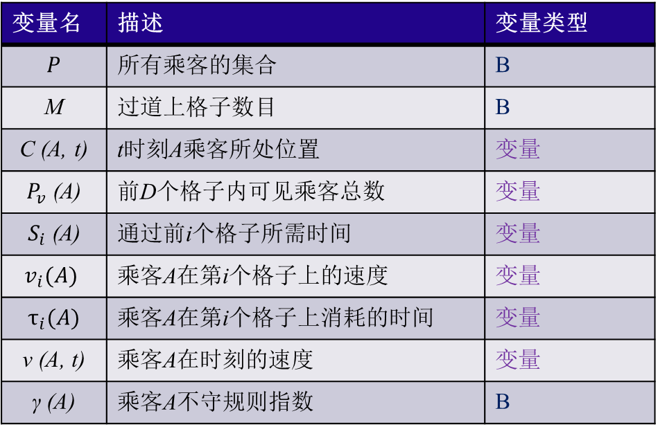
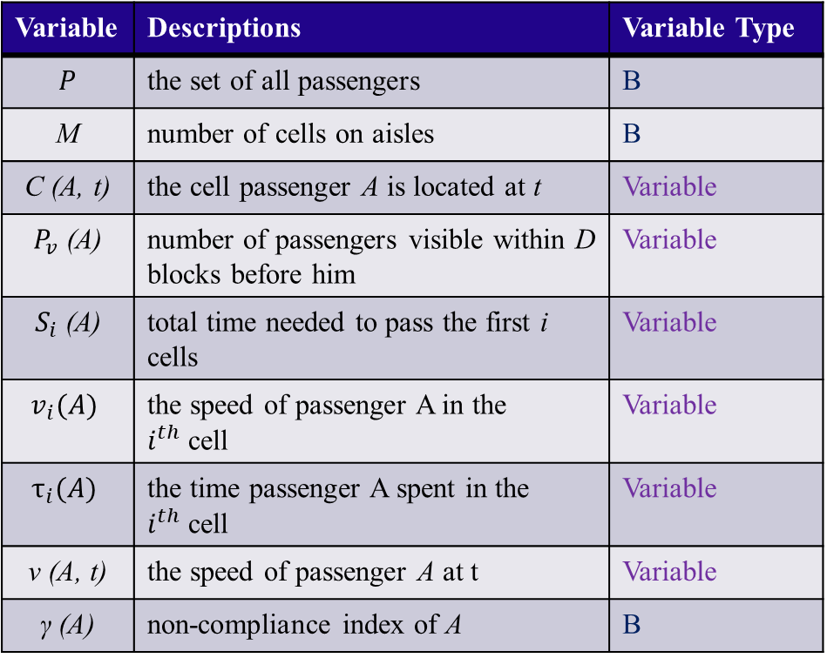
Notation
Variable | Descriptions | Variable Type
$$P$$ | the set of all passengers | B
M | number of cells on aisles | B
C (A, t) | the cell passenger A is located at t | Variable
$P_{v}$ (A) | number of passengers visible within D blocks before him | Variable
$S_{i}$ (A) | total time needed to pass the first i cells | Variable
$$v_{i}(A)$$ | the speed of passenger A in the $i^{th}$cell | Variable
$$τ_{i}(A)$$ | the time passenger A spent in the $i^{th}$cell | Variable
$$\text{v}\text{ (}\text{A}\text{, }\text{t}\text{)}$$ | the speed of passenger A at t | Variable
$$\text{γ}\text{ (}\text{A}\text{)}$$ | non-compliance index of A | B
变量名 | 描述 | 变量类型
$$P$$ | 所有乘客的集合 | B
M | 过道上格子数目 | B
C (A, t) | t时刻A乘客所处位置 | 变量
$P_{v}$ (A) | 前D个格子内可见乘客总数 | 变量
$S_{i}$ (A) | 通过前i个格子所需时间 | 变量
$$v_{i}(A)$$ | 乘客A在第i个格子上的速度 | 变量
$$τ_{i}(A)$$ | 乘客A在第i个格子上消耗的时间 | 变量
$$\text{v}\text{ (}\text{A}\text{, }\text{t}\text{)}$$ | 乘客A在时刻的速度 | 变量
$$\text{γ}\text{ (}\text{A}\text{)}$$ | 乘客A不守规则指数 | B

Slide 3
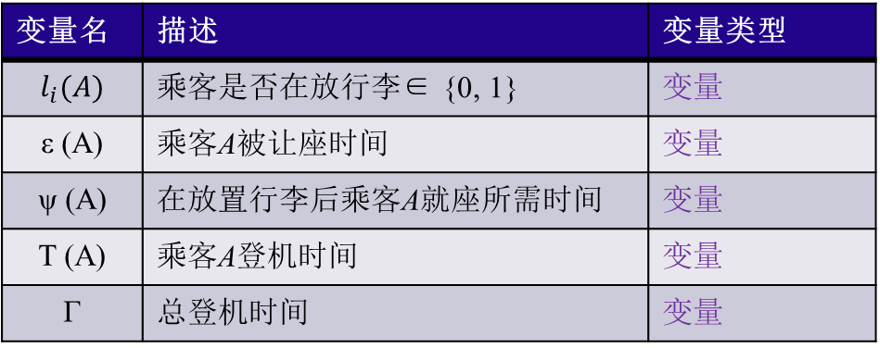
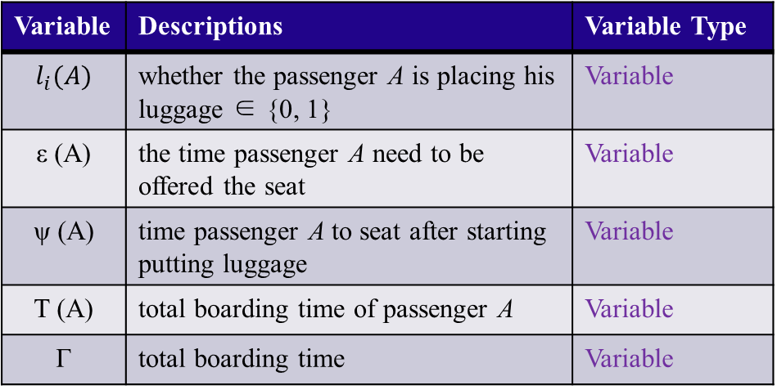
Notation
Variable | Descriptions | Variable Type
$$l_{i}(A)$$ | whether the passenger A is placing his luggage ∈ {0, 1} | Variable
ε (A) | the time passenger A need to be offered the seat | Variable
ψ (A) | time passenger A to seat after starting putting luggage | Variable
T (A) | total boarding time of passenger A | Variable
Γ | total boarding time | Variable
变量名 | 描述 | 变量类型
$$l_{i}(A)$$ | 乘客是否在放行李∈ {0, 1} | 变量
ε (A) | 乘客A被让座时间 | 变量
ψ (A) | 在放置行李后乘客A就座所需时间 | 变量
T (A) | 乘客A登机时间 | 变量
Γ | 总登机时间 | 变量

